Slide 1
Superconductivity, Superconducting RF & Superconducting Magnets
J. G. Weisend II

Slide 2
Goals
Describe the basic physics behind superconductivity (mainly low T_{C} )
Describe the requirements of practical superconducting materials
Describe how superconducting materials are turned into practical conductors for applications
Discuss superconducting magnets including stability, protection and show an example
Discuss superconducting radiofrequency systems (SCRF)
Touch briefly on HiT_{C} superconductivity

Slide 3
Introduction
As we’ve seen, superconductivity is a major motivating factor for the use of cryogenics – particularly in accelerators but also in commercial systems such as MRI
Cryogenic engineers will frequently be called upon to design systems to cool and keep cold superconducting equipment
Thus, understanding the requirements of superconductors is an important part of the training of a cryogenic engineer.
What is a superconductor?
  A superconductor is a material that conducts DC electrical current with zero resistive losses under certain specific conditions
    When in the superconducting state the resistive loss is identically zero not just vanishingly small but zero

Slide 4
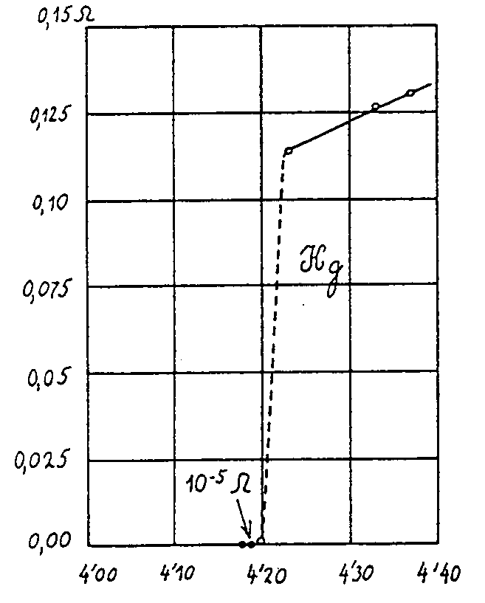
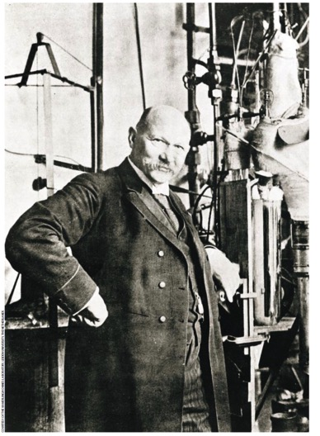
Discovery of Superconductivity
H. Kamerlingh-Onnes June 9, 1911 – University of Leiden
  Kamerlingh-Onnes had previously been the first to liquefy helium in 1908
  Having liquid helium available enabled this discovery

Slide 5
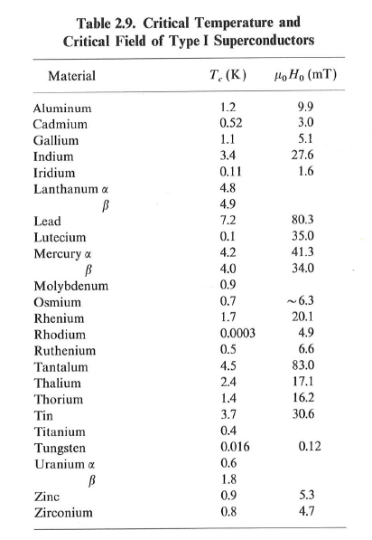
Conditions for Superconductivity
Critical Temperature
  All superconductors have a temperature
  above which they no longer
  become superconducting
This is an obvious condition but by no means
the only condition
To understand the other conditions we need
to understand the magnetic properties of
superconductors
Not all materials are superconductors
– most in fact aren’t
From: Helium Cryogenics
Van Sciver

Slide 6
Superconductors & Magnetism
Superconductors are also perfect diamagnets i.e. they expel all magnetic field (the Meissner effect)
  This is a different result than if we considered the material as a pure conductor
    This is demonstrated by the “floating magnet” trick
If the applied magnetic field exceeds a certain level, the superconductor reverts back to a normal conductor.
Critical Field
  All superconductors have a field above which they become normally conducting

Slide 7
Superconductors & Magnetism

Slide 8
Type II Superconductors
Some superconductors have 2 critical fields: below the first (H_{c1}) all magnetic flux is expelled from the material. Above the first but below the second (H_{c2}) the flux penetrates in the form of quantized magnetic fields or fluxons. In this “mixed state” the bulk of the material remains superconducting
Such material are called Type II superconductors
Type II materials tend to be alloys though Nb is an important Type II superconductor
Type II superconductors have much (orders of magnitude) higher upper critical fields and thus are more useful in technology

Slide 9
Type II Superconductors
Type I (κ < 1/√2)
Complete field exclusion
Pure metals
B_{C} ≈ 10⁻³…10⁻² T
Type II (κ > 1/√2)
Partial field exclusion
Lattice of fluxons
Dirty materials: alloys intermetallic, ceramic
B_{C} ≈ 10…10² T
Ginzburg, Landau, Abrikosov, Gor’kov, 1950…1957

Slide 10
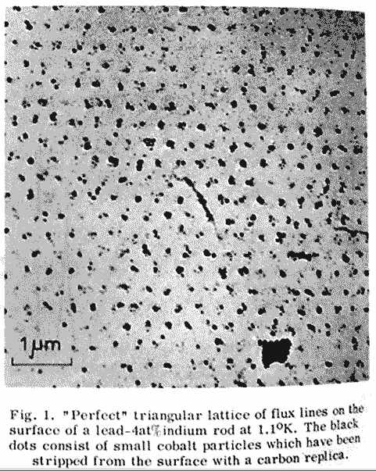
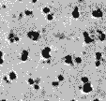
Fluxons can be directly seen
(note similarity to quantized vortices in He II)
Courtesy L. Boturra of CERN
Supercurrent
Flux quantum
Φ₀ = h/2e = 2.07 x 10⁻¹⁵ Wb
Observation on Pb-4at% In magnetised by a field of 3000 Oe and decorated by Co particles
Essmann & Träuble, 1967

Slide 11
Critical Current
A third parameter in superconductivity is critical current. If the critical current is exceed superconductivity breaks down
The current in a superconductor stems from 2 causes. The transport current and the shielding currents required for the Meisser or mixed states. Thus, the critical current and critical fields are related.
If we exceed the critical current ( frequently expressed as critical current density J_{c} ) critical temperature or critical field the material stops being a superconductor
  We call this “going normal” or Quenching
  Thus the point at which a material is superconducting becomes a 3D space

Slide 12
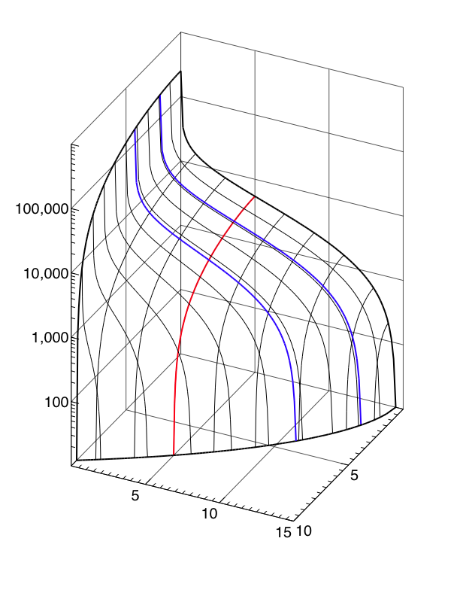
LHC NbTi Wire
J_{c} [A/mm²]
Courtesy L. Boturra of CERN
T=1.9 K
T=4.2 K
B = 5 [T]
Note Improvement in B and Jc
@ T = 1.9 K
100,000
10,000
1,000
100
B [T]
T [K]
5
5
Jc (5 T, 4.2 K) ≈ 3000 A/mm²
10
10
15

Slide 13
Flux Pining
In Type II superconductors the Lorentz force caused by the interaction between the current and the magnetic field will cause the fluxons to move.
Movement of the fluxons will cause heating and thus quenching of the superconductor
From Engineering Superconductivity
P. Lee

Slide 14
Flux Pining
In practical superconductors the fluxons are pined to prevent movement – this allows higher current densities.
Pinning sites are created by complicated metallurgical processes (heat treatments, cold work and alloying)
This development over the last 30 years has been a major victory in developing practical superconductors for applications

Slide 15
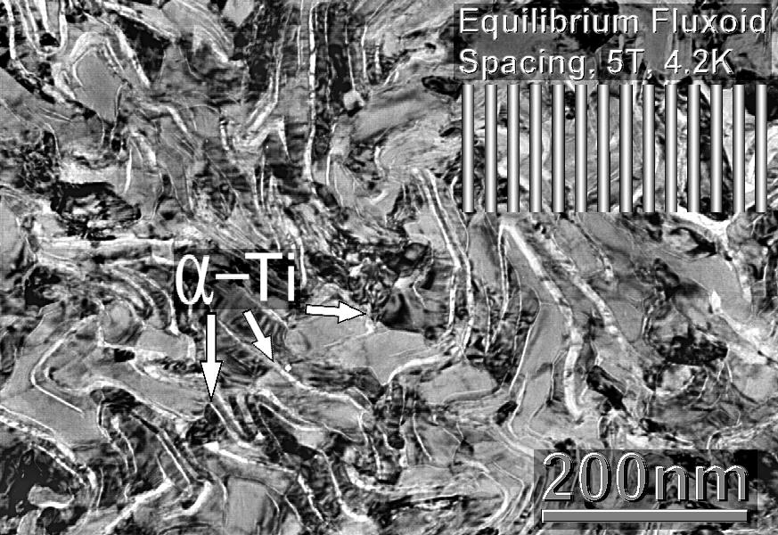
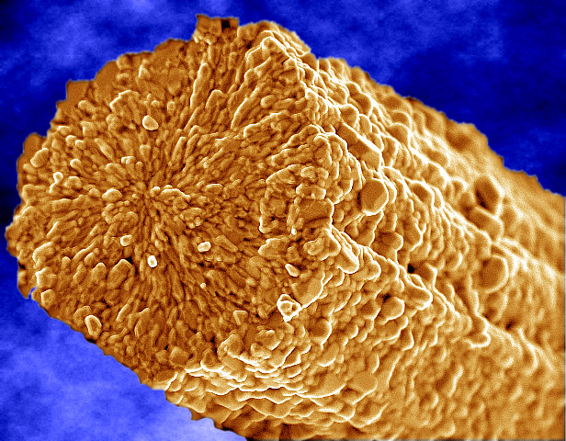
Flux Pining Sites
Courtesy L. Boturra of CERN
Grain boundaries in
inter-metallic compounds
Precipitates in alloys
Microstructure of Nb-Ti
Microstructure of Nb₃Sn

Slide 16
But Wait!
What Causes Superconductivity?
The following is a very hand waving explanation of the origin of low temperature superconductivity
There is a very elegant, accurate and complicated description of low temperature superconductivity:
  This is the Bardeen-Cooper- Schrieffer theory or BCS theory
Simply put
  Electrons in the material are linked together into Cooper pairs via an attractive force that comes from the oscillations of the (positively charged) lattice
  These Cooper pairs now act more like bosons and in a sense undergo a Bose-Einstein condensation similar to that seen in He II
  This “condensate” in effect acts as one “unit” you can not scatter or change the energy of a single electron without changing the energy of all of them
    There is thus an energy gap and unless the energy of interactions exceeds this value there is no scattering and thus no resistance
BCS theory explains and predicts observable behavior in low Tc superconductors

Slide 17
Another Way to Model Superconductivity is via the “Two Fluid Model”
This imagines superconducting materials as being composed of two kinds of electrons : Those in Cooper pairs and those not in Cooper pairs
  Above T_{C} there are no Cooper pairs
  At absolute zero all electrons are in Cooper pairs
In DC applications the Cooper pairs carry all the electric current and thus there is zero resistance
But in AC (i.e. RF) applications the oscillating electric field affects both the Cooper pairs & the non paired electrons & the movement of the non paired electrons result in resistance.
  Thus there is always electrical loss in AC superconductivity
A similar model is also used to describe He II

Slide 18
Impact of Changing Currents
In addition to the intrinsic losses caused by AC currents in superconductors. There are additional AC losses that can be reduced via superconductor design
They are broadly speaking 2 major sources of additional AC losses in superconductors: hysteresis (caused by flux jumping) and losses caused by AC coupling between adjacent filaments.
See Backup slides for additional details

Slide 19
Practical Superconductors
Superconductors are relatively poor conductors when normal
Superconductors do have resistive losses when the current is varied
Superconductors can’t generally be used as a bulk material. They are divided into filaments (tens of μm in DIA) housed in a good conductor (known as a stabilizer) matrix. This:
  Prevents flux jumping and resultant heating
  Increases stability
Groups of filaments themselves are also twisted into a cable to reduce coupling and resulting AC losses in the cables
AC fields also induce eddy current losses in the good conductor within which the superconducting filaments are housed
The two workhorse practical low Tc superconductors are:
  Nb Ti (ductile)
  Nb₃Sn ( higher Jc and Hc but a brittle inter metallic compound)

Slide 20
Practical Superconductors
It’s important to note that while superconductivity was discovered in 1911, practical high current density superconducting materials were developed until the 1960s and weren’t suitable for wide spread technological applications (understanding flux pining, manufacturing techniques ) until the 1980’s
This has implications for applications using the much more complicated HiTc superconductors
How do we create superconducting wire?

Slide 21
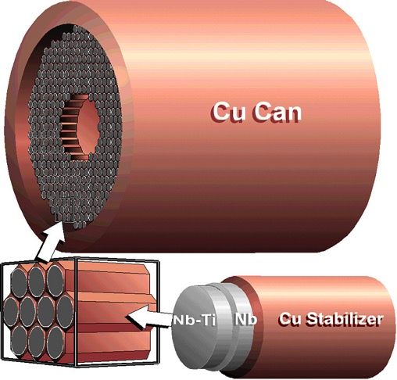
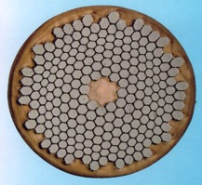
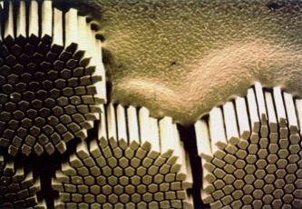
Nb-Ti manufacturing route
Graphics by courtesy of Applied Superconductivity Center at NHMFL
slide courtesy of L. Boturra - CERN
NbTi billet
I_{C}(5 T, 4.2 K) ≈ 1 kA
extrusion
cold drawing
≈1 mm
heat
treatments
LHC wire
NbTi is a ductile alloy that can sustain large deformations

Slide 22
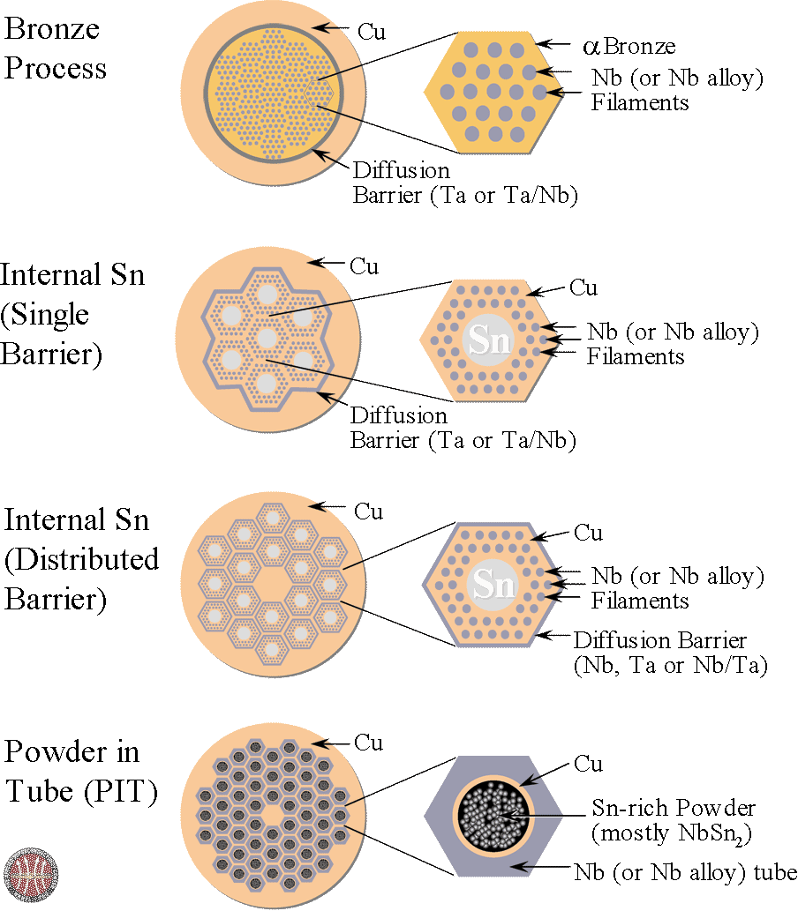
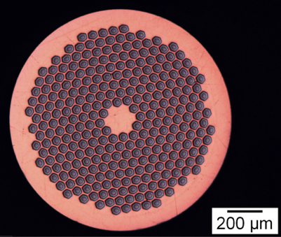
Nb₃Sn manufacturing routes
Graphics by courtesy of Applied Superconductivity Center at NHMFL
Nb₃Sn is brittle and cannot be drawn in final form. The precursors are drawn and only later the wire is heat-treated to ≈650 C, to form the Nb₃Sn phase
I_{C}(12 T, 4.2 K) ≈ 1.5 kA
slide courtesy of L. Boturra - CERN

Slide 23
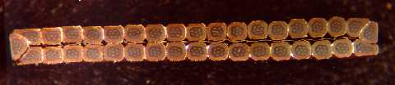
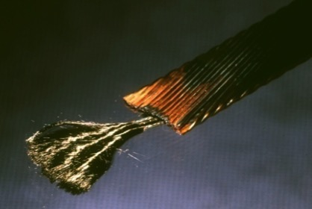
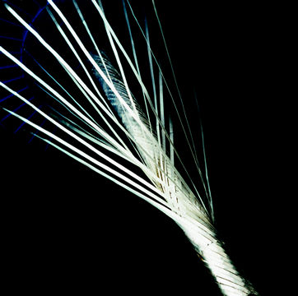
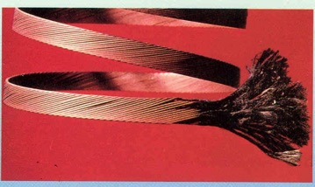
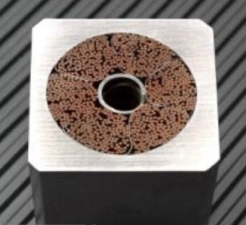
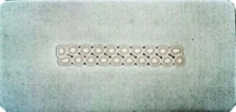
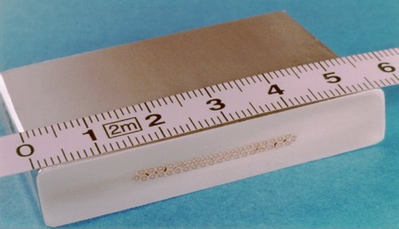
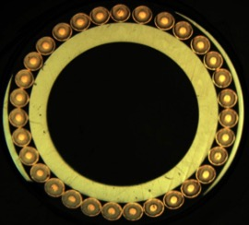
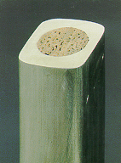
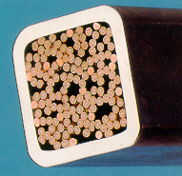
Superconducting cables
Braids for
power transmission
CICC
Rutherford
Super-stabilized
Internally cooled
slide courtesy of L. Boturra - CERN

Slide 24
Superconducting Radio Frequency Cavities
From the 70’s to the 90’s the principle application of superconductivity in particle accelerators was in the area of s/c magnets (Tevatron, HERA, LHC)
Since then, for a variety of reasons ( e.g. technical advances in SRF and the growth of linac applications) the use of SRF cavities for particle acceleration has become increasingly important and in many cases is the primary application of superconductivity & cryogenics in accelerator designs

Slide 25
He II Cooling in SRF is Very Popular
Name | Location | Purpose | Status (as of June 2023) | Comments
LCLS II | USA | FEL Driver | Operating | TESLA Technology
XFEL | Germany | FEL Driver | Operating | TESLA Technology
FLASH | Germany | FEL Driver | Operating | TESLA Technology
SHINE | China | FEL Driver | Under Construction | TESLA Technology
S³FEL | China | FEL Driver | Under Construction | TESLA Technology
DALS | China | FEL Driver | Proposed | TESLA Technology
CEBAF | USA | Electron Linac for Nuclear Science | Operating
SNS | USA | Proton Driver for a spallation neutron source | Operating
ESS | Sweden | Proton Linac for a spallation neutron source | Beam on dump in Spring 2025
PIP II | USA | Proton Linac for high energy physics | Under Construction
FRIB | USA | Heavy Ion Linac | Operating
RAON | South Korea | Heavy Ion Linac | Commissioning
ILC | Japan | Electron/Positron Collider for High Energy Physics | Proposed | TESLA Technology
S-DALINAC | Germany | FEL Driver, Nuclear Physics & Accelerator R&D | Operating | Extrapolation of TESLA Technology
CBETA | USA | Test Accelerator | Operating | TESLA Technology
MINERVA | Belgium | Proton Linac for Accelerator Driven Reactor | Under Construction
CIADS | China | Proton Linac for ADS | Under Construction

Slide 26
Basics of SRF Cavities
SRF cavities deserve their own lecture. (See lecture 12)
This will be a brief overview of the basics of SRF cavities.
Practical cavity material is pure Niobium
Cavities have beam vacuum on the inside (usually separate from insulation vacuum) and are surrounded and cooled by a bath of saturated LHe
Cavities come in all shapes and frequencies (~ 80 MHz – 3.9 GHz) depending on the accelerator design)

Slide 27
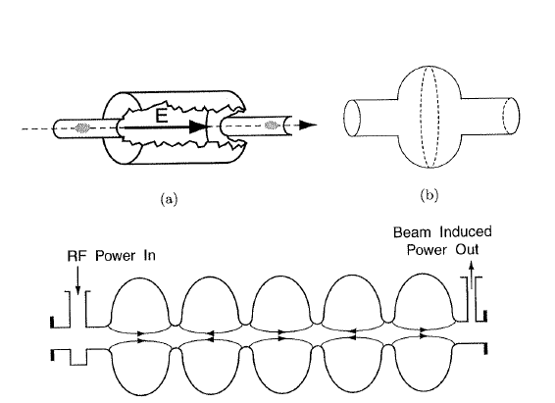
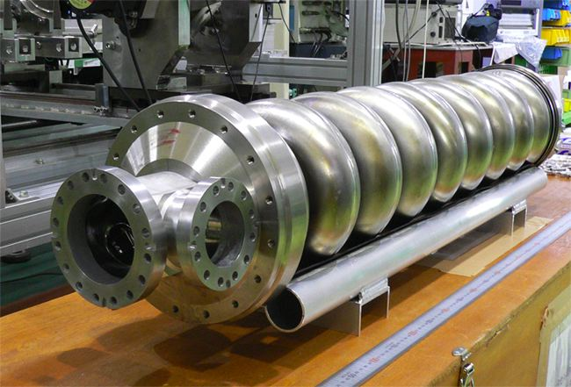
Examples of SRF Cavities
High Beta
  Typically elliptical in design
ILC cavity 1.3 GHz
1 m long – also LCLS II
From H. Padamsee et al.
Superconducting RF for Accelerators

Slide 28
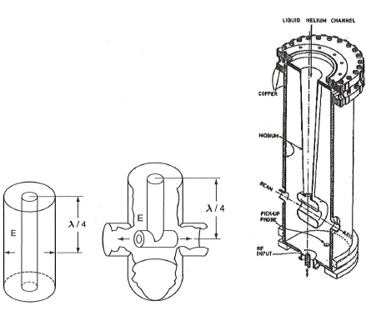
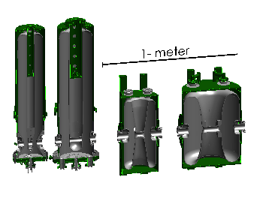
Examples of SRF Cavities
Low Beta
¼ wave & ½ wave cavities
From H. Padamsee et al.
Superconducting RF for Accelerators
FRIB Cavities

Slide 29
Surface Resistance, Frequency and Temperature
The RF surface resistance (which we want to minimize) of a SRF cavity is given by:
The surface resistance goes up with frequency and down with temperature: lower temperature equals less resistance, particularly at higher frequencies
Removing heat at lower temperatures is less thermodynamically efficient, thus there is also an energy cost to be paid for operating at lower temperatures.
What is the optimal temperature?
  Above about 500 – 700 MHz you win by operating below 4.2 K ( typically 1.8 – 2 K)
  At lower frequencies (e,g. 80 MHz) you are better at 4.2 K thermodynamically but there may be other considerations (FRIB)
  Between these limits it’s a fairly broad minimum. Most systems operate ~ 2 K – He II

Slide 30
Cavity Performance
Two of the main parameters for describing Cavity performance are the accelerating gradient E_{acc} ( MV/m) and the cavity quality factor Q₀
Q₀ is defined as the energy stored in the cavity divided by the energy lost in one RF period
  Q₀ is related to the surface resistance. The lower the surface resistance the higher the Q₀ and the lower the energy deposited into the cavity wall and cryogenic system Thus the higher the Q_{o} the better

Slide 31
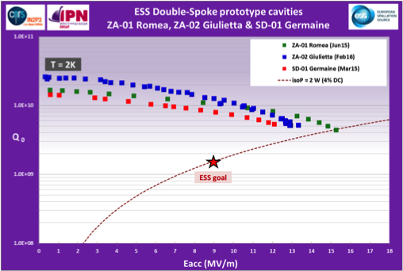
Example of SRF Cavity Performance
ESS Double Spoke Cavities

Slide 32
Cavity Performance Can Be Degraded
By a Number of Phenomena
Quenching or thermal break down – normal ( non superconducting) zones develop in the cavity
Field Emission – electrons are pulled off the surface of the cavity and accelerated by the RF field (degrades Q₀)
Local Magnetic Fields

Slide 33
Cavity Processing
Research has shown that both Field Emission and Thermal Breakdown can be significantly reduced by proper processing of the cavities. This processing consists of an intricate set of steps involving:
  Cavity surface cleaning by chemicals (buffered chemical processing) or by electropolishing
  Cavity surface cleaning by High Pressure Rising with ultrapure water
  Various heat treatments
Major progress in this area has made SRF cavities much more useful
  CEBAF ( 1980’s) designed for 5 MV/m (actual performance was better) CEBAF 12 GeV upgrade (2000’s) specified & met 19.2 MV/m
  ILC cavity specification is 35 MV/m

Slide 34
Cavity Cleanliness
Once processed, the RF surface i.e. the beam vacuum surface of the cavities must be kept extremely clean to maintain performance. This results in:
  Assembly of cavity strings in cleanrooms
  Connection of beam tube vacuums within local cleanrooms during cryomodule installation
  Very strict vacuum and particle free requirements for cavity systems
  Presence of fast acting valves to subdivide beam vacuum in the case of accidents

Slide 35
Other Aspects of SRF Cavities
Q Disease – related to interstitial hydrogen in the niobium.
  Can be treated via heat treatments or may set limits on cavity cool down and warm up rates
Local magnetic fields ( including the Earth’s) degrade cavity performance
  Result is that cavities are designed with passive and sometimes active magnetic shields. Use of magnetic materials near cavities must be carefully examined
Cavities are resonant structures that require tuning frequently at cryogenic temperatures

Slide 36
Other Aspects of SRF Cavities
Vibrations (microphonics) can detune cavities depending on cavity stiffness and design
  This may put strict limits on vibrations near cavities
  Use of He II ( see later lecture) prevents bulk boiling in the helium bath that may affect the cavity tune

Slide 37
High Temperature Superconductivity
First Discovered in 1986 in Yttrium Barium Copper Oxide
(YBa₂Cu₃O_{7-x}), referred to commonly as YBCO - Tc ~92 K
Many other similar ceramic materials soon followed such as Bi₂Sr₂Ca₂Cu₃O₆ (Bi-2223) – Tc ~ 110 K and HgBa₂Ca₂Cu₃O₈ (Hg-1223) – Tc ~ 134 K
This lead to the so-called “Woodstock of Physics” at the 1987 APS March Meeting in NYC
Despite the initial excitement technical progress has been slow and HiTc superconductors have a number of issues:
  While the Tc is high the critical current was (at least initially) is quite low
  These materials are anisotropic (performance depends on their orientation)
  These materials are brittle ceramics and thus very hard to turn into wires
  BCS theory doesn’t explain the presence of superconductivity in these materials – no good theory exists though some type of coherent phenomena must be behind it.

Slide 38
High Temperature Superconductivity
But don’t despair !
  Remember superconductivity was discovered in 1911 but practical low Tc superconductors really didn’t arrive until the 80’s
There are commercial niche applications of HiTc superconductors even today
HiTc current leads for providing current to low Tc s/c magnets
  These leads allow superconductivity up to about 50 – 80 K and serve to reduce the overall heat leak into the LHe space since HiTc materials are poor thermal conductors
Superconducting electronics in the form of low noise microwave filters for use in cell phone towers operating at about 50 K
Note also the temperature range for HiTc superconductors ( ~ 50 – 200 K ) ties in nicely with the performance range for small cryocoolers
  The development of small cryocoolers and rise of HTS applications have gone hand in hand

Slide 39
High Temperature Superconductivity
Binary Current Leads
From Choi et al.
Adv. Cryo. Engr. Vol 55 (2010)

Slide 40
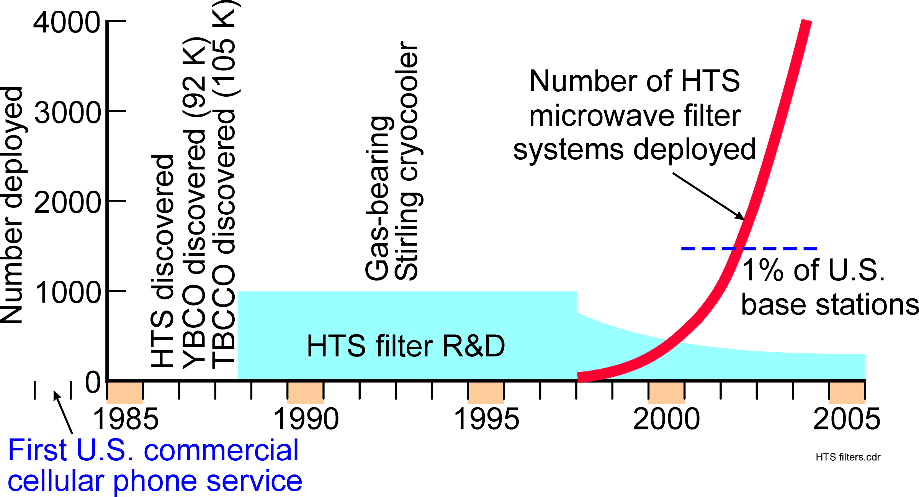
Use of HTS Microwave Filters in Cell Phone Base Stations
Courtesy R. Radebaugh

Slide 41
Stability of Superconducting Magnets
When a wire in a s/c magnet undergoes a temperature rise, there are 2 possibilities:
  It can cool back down and remain superconducting
  It can warm up above Tc and “quench” (become normally conducting in all or most of the magnet)
Which one occurs depends on the amount of heat generation and cooling

Slide 42
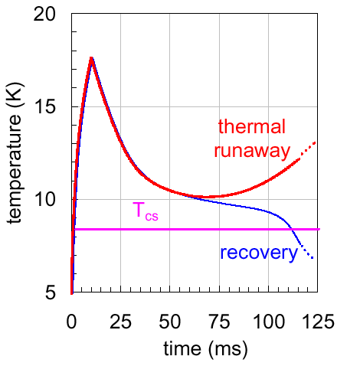
A Genaric Temperature Transient
…effect of heat conduction and cooling…
heat pulse…
generation>cooling
unstable
generation<cooling
stable

Slide 43
Perturbation spectrum
mechanical events
    wire motion under Lorentz force, micro-slips
    winding deformations
    failures (at insulation bonding, material yeld)
electromagnetic events
    flux-jumps (important for large filaments, old story !)
    AC loss (most magnet types)
    current sharing in cables through distribution/redistribution
thermal events
    current leads, instrumentation wires
    heat leaks through thermal insulation, degraded cooling
nuclear events
    particle showers in particle accelerator magnets
    neutron flux in fusion experiments, separator magnets
slide courtesy of L. Boturra - CERN

Slide 44

Current Sharing
T < T_{cs}
stabilizer
superconductor
stabilizer
superconductor
T_{cs} < T < T_{c}
I_{C}
curent sharing
I_{op}
T > T_{c}
quenched
T_{op}
T_{CS}
T_{C}
T

Slide 45
Stability of Superconducting Magnets
Fully cryostable: magnet will recover regardless of size of normal zone ( disturbance) May be true of large detector magnets e.g BaBar detector or MRI magnets, but generally magnets are conditionally stable up to some heat input level.
Adiabatic stability: magnet will recover if heat input is not too big – more typical of accelerator magnets or potted-coil magnets

Slide 46
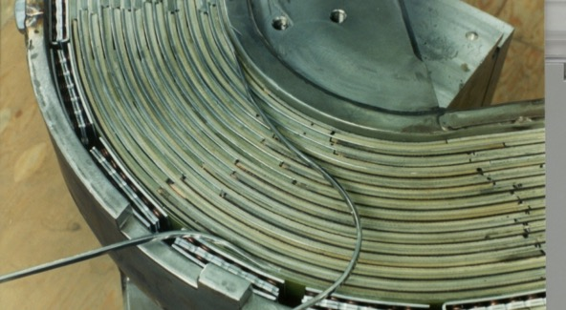
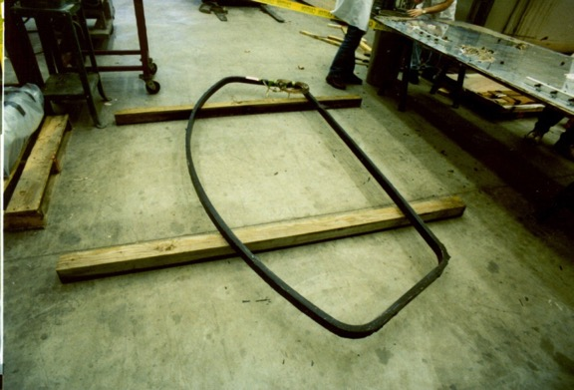
Stability of Superconducting Magnets(2)
Why not make all magnets fully cryostable?
S800 dipole coil
A1900 dipole coil
S800 dipole coil took 6 weeks to wind
A1900 dipole coil took 2 days

Slide 47
Criteria for Fully Cryostable Magnets
Stekley Criteria – most conservative, doesn’t account for end cooling
< 1 magnet is stable
Equal area theorem
  Takes into account the cooling of the conductor via conduction at the ends
  Can be expressed as a graphical solution comparing the areas under the cooling and heating curves ( see references )
There are many cooling options for S/C magnets and SRF cavities – see lecture 15

Slide 48
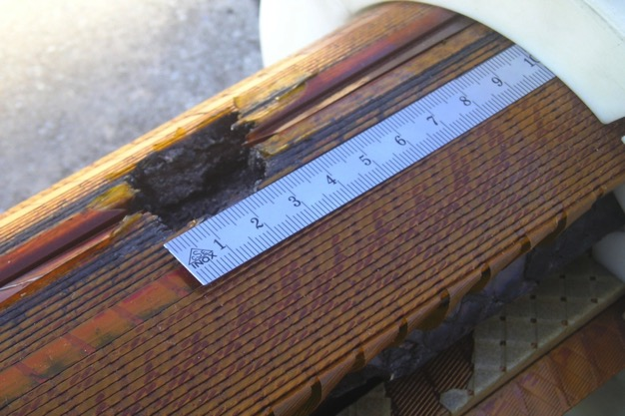
Quench Detection & Protection
Superconducting magnets store large amounts of energy either individually (20 MJ for the Babar detector magnet) or connected in series (10’s of GJ)
If all the energy is deposited in a small volume, bad things happen!

Slide 49
Quench Detection & Protection
The goal is to rapidly and accurately detect the quench and safely dispose of the energy
  Spread throughout the magnet
  In an external dump resistor
  In a coupled secondary
  In magnet strings, bypass the energy of the other s/c magnets away from the quenching one
Remember it’s the stored energy in the magnet(s) not the power supply that’s problem (S/C magnet power supplies are low voltage, high current, so increased resistance in a quenched magnet prevent further power input)

Slide 50
Detecting Quenches
Can’t just measure voltage directly as magnet ramping causes voltage and give a false signal
The general approach is to subdivide the magnet with voltage taps and build a bridge circuit that cancels out voltage due to ramping
Redundant QD systems are necessary
Other measurements such as temperature, helium level or vacuum level might be used to look for precursors to trouble but take care not to “over interlock the magnet”
HTS magnets are of special concern due to slow quench propagation, so sensitive QD required

Slide 51
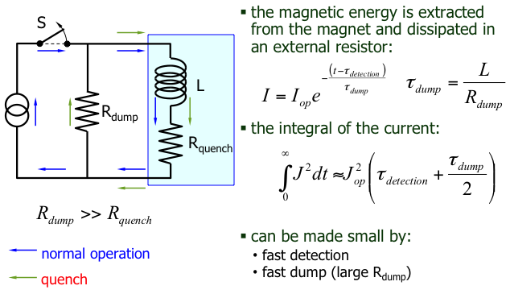
Strategy: energy dump
B.J. Maddock, G.B. James, Proc. Inst. Electr. Eng., 115, 543, 1968
slide courtesy of L. Boturra - CERN

Slide 52
Strategy: heaters
advantages:
  homogeneous spread of the magnetic energy withn the winding pack
disadvantages:
  active
  high voltages at the heater
  Doesn’t work well with highly stable magnets
the quench is spread actively by firing heaters embedded in the winding pack, or in close vicinity to the conductor
heaters are mandatory in:
  high performance, aggressive, cost-effective and highly optimized magnet designs (high current density)…
  …when you are really desperate
heater
winding
slide courtesy of L. Boturra - CERN

Slide 53
Magnet strings
magnet strings (e.g. accelerator magnets, fusion magnetic systems) have exceedingly large stored energy (10’s of GJ):
    energy dump takes very long time (10…100 s)
    the magnet string is subdivided and each magnet is by-passed by a diode (or thyristor)
    the diode acts as a shunt during the discharge
M₁
M₂
M₃
M_{N}

Slide 54
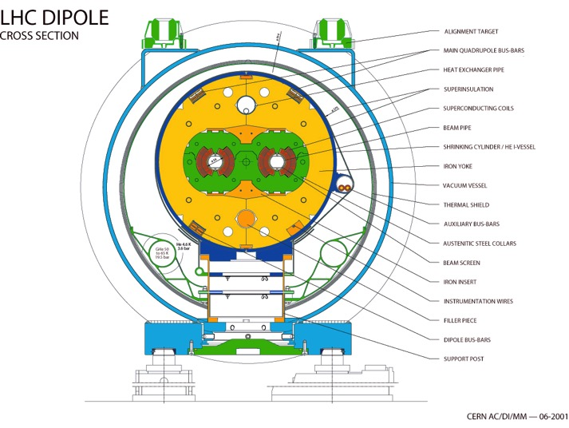
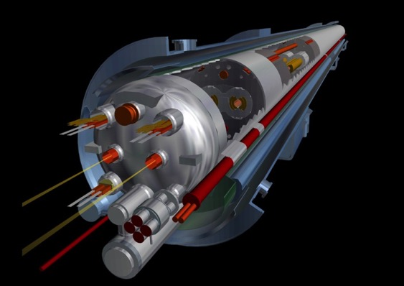
Example #1 LHC Dipole
B_{nominal} 8.3 (T)
current 11850 (A)
stored energy ≈ 8 (MJ)
cold mass ≈ 35 (tonnes)
slide courtesy of L. Boturra - CERN

Slide 55
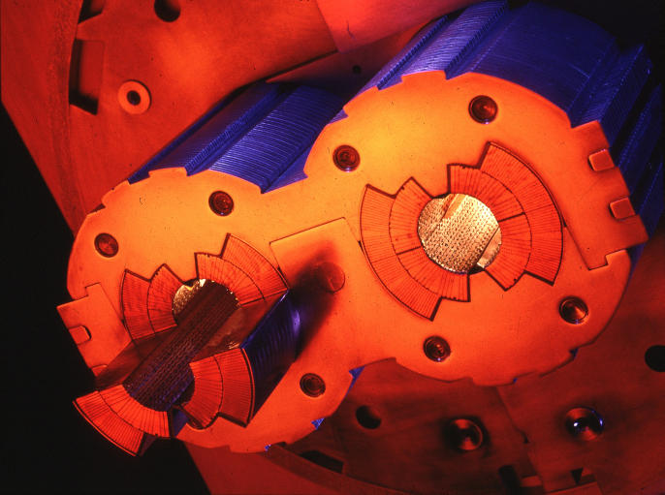
LHC dipole coils
B
B
slide courtesy of L. Boturra - CERN

Slide 56
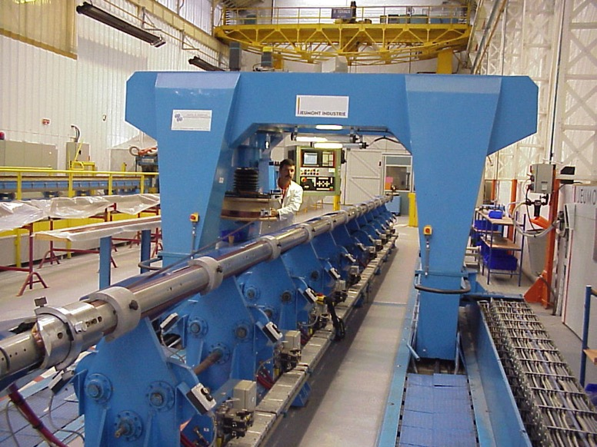
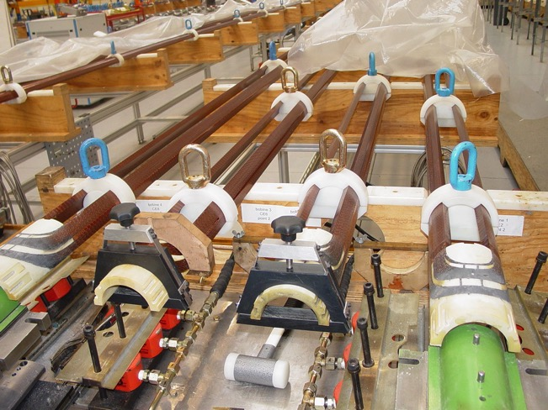
Coil winding
Cable insulation
10 μm precision !
Stored coils
B
B
Coil winding machine
slide courtesy of L. Boturra - CERN

Slide 57
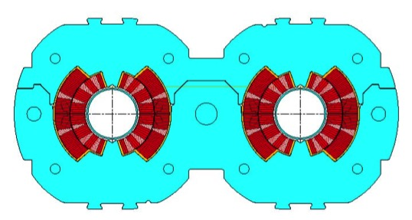
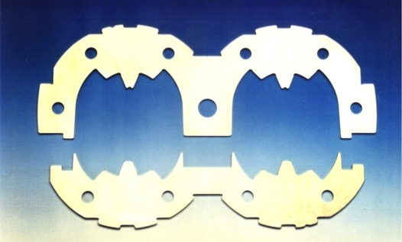
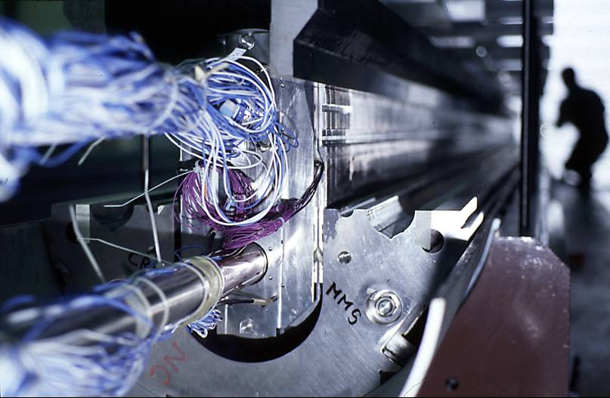
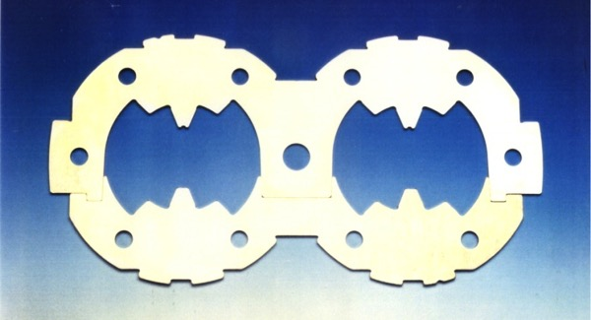
Collaring and yoking
85 tons/m
F
175 tons/m
yoking
collaring
slide courtesy of L. Boturra - CERN

Slide 58
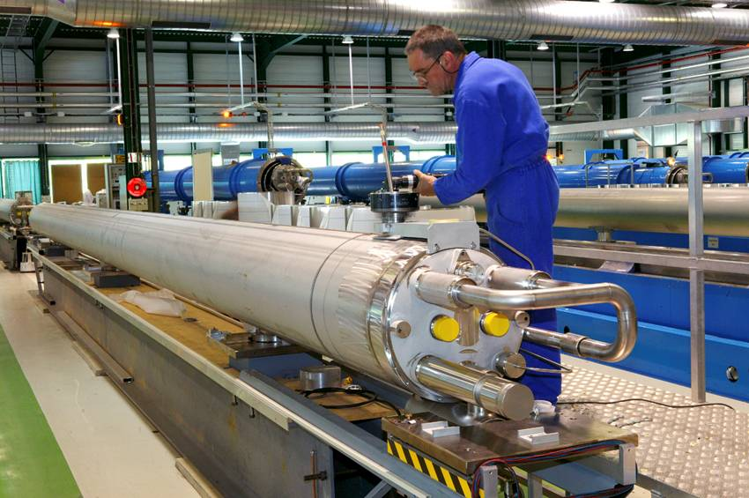
Cold mass
slide courtesy of L. Boturra - CERN

Slide 59
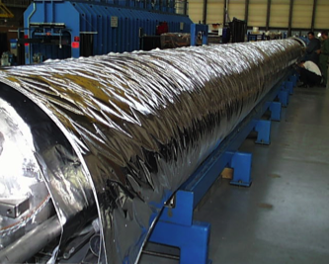
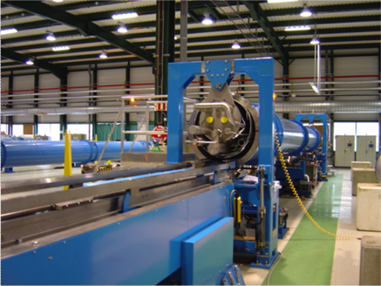
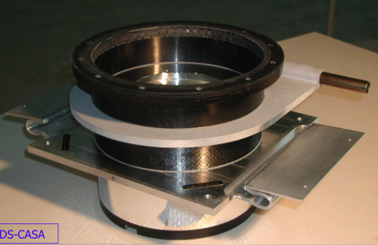
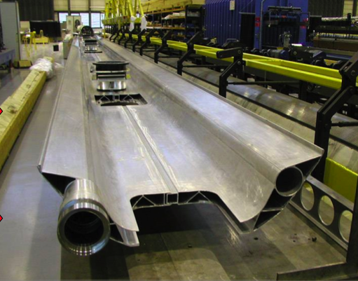
Cryostat
MLI
Thermal screens
Low conduction foot

Slide 60
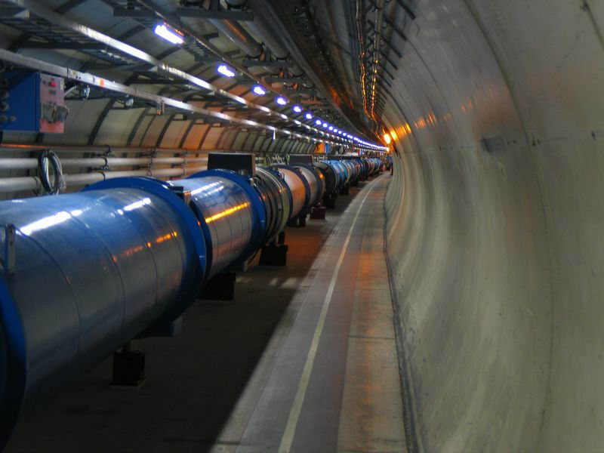
Finally, in the tunnel !
slide courtesy of L. Boturra - CERN

Slide 61
Example #2
BaBar Detector S/C Solenoid
Provided background field for particle identification for the BaBar detector at SLAC
Physics requirements dictated a relatively thin solenoid

Slide 62
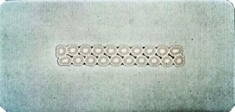
Properties of BaBar Solenoid
Field: 1.5 Tesla
Stored Energy: 27 MJ
Operating Current: 4596A
Tc= 8.3K
Operating Temp: 4.5K
Total Heat Load at 4.5K: 225liquid-liters/hr
Cryogenics: indirectly cooled using the force flow technique where the liquid He is circulated in cooling pipes welded to the outside diameter of the support tube
Uses NbTi highly stabilized by a pure Al conductor

Slide 63

BaBar Detector Under Construction

Slide 64
BaBar Detector

Slide 65
BaBar Solenoid
Operated almost continuously for ~ 10 years
Was very stable – only discharged due to loss of power, controls or cooling
  Availability was > 96% from the start and better than 98% during final 3 years
    Improvement due mainly to removing unnecessary interlocks and adding additional utility backups

Slide 66
Conclusions
Superconducting magnets & SRF Cavities make possible modern accelerators : LHC, ILC, ESS, FAIR, SNS, JLAB, LCLS II
Superconducting magnet design involves detailed engineering on a scale from the microscopic (flux pinning) to the immense (multi ton, GJ magnets)
Superconducting magnet design involves a wide range of disciplines: materials science, electrical engineering, mechanical design, cryogenics etc.
Superconducting magnet requirements have driven and enabled many advances in s/c materials, wire and ancillary systems
HTS are still under development but significant niche markets are appearing

Slide 67
Back Up Slides

Slide 68
Flux Jumps
slide courtesy of L. Boturra - CERN
Unstable behavior is shown by all superconductors when subjected to a magnetic field:
  B induces screening currents, flowing at critical density J_{C}
  A change in screening currents allows flux to move into the superconductor
  The flux motion dissipates energy
  The energy dissipation causes local temperature rise
  J_{C} density falls with increasing temperature
ΔQ
Δφ
ΔT
J_{C}
Flux jumping is cured by making superconductor in the form of fine filaments. This weakens the effect of Δφ on ΔQ

Slide 69

Filaments coupling
loose twist
tight twist
slide courtesy of L. Boturra - CERN
dB/dt
dB/dt
All superconducting wires and are twisted to decouple the filaments and reduce the magnitude of eddy currents and associated loss

Slide 70

Coupling in cables
slide courtesy of L. Boturra - CERN
⊗ dB/dt
+I
−I
eddy current loop
cross-over contact R_{c}
The strands in a cable are coupled (as the filaments in a strand). To decouple them we require to twist (transpose) the cable and to control the contact resistances

